Slide 1

Deep Learning for Images
By Dendi Suhubdy
Statistical Learning Group (SLG) North Carolina State University

Slide 2

Brief Introduction of Machine Learning How did we even get here?

Slide 3
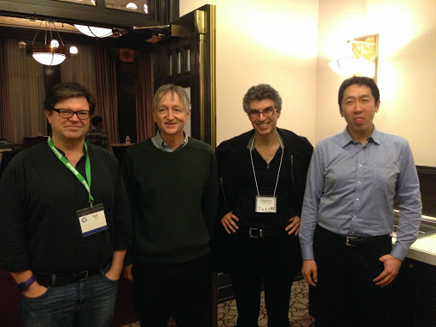
The Believers

Slide 4
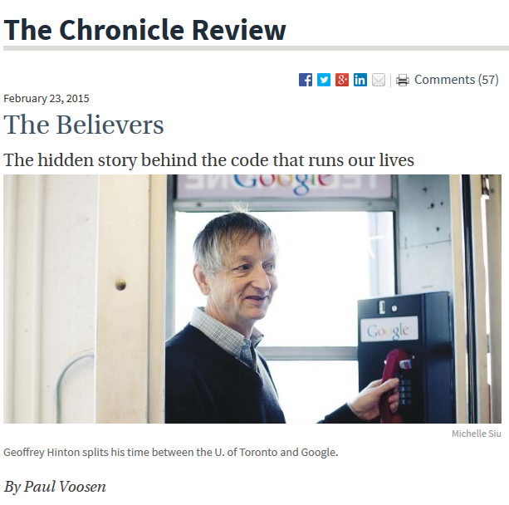

Slide 5
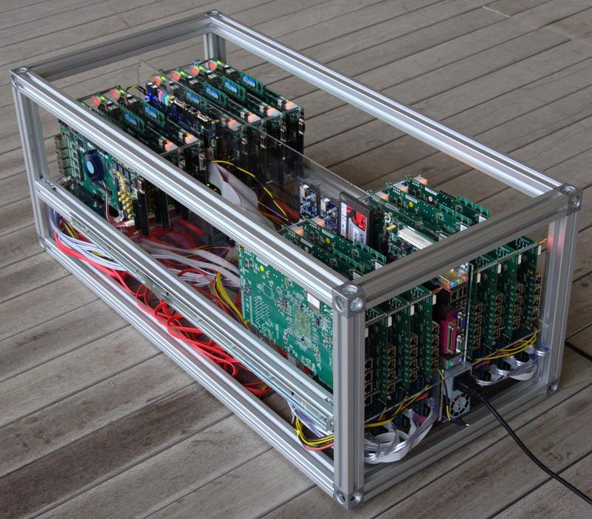
The old way?
Old approach to machine learning
Supervised algorithms
Specific algorithms
Train’em
Tell’em what to do
Pros
Easy to understand in statistical term
Easy to derive (owh yeah boy we are in NC State Stats!!!)
Low computational power needed
Cons
Are not useful for generalized approach.

Slide 6


Theeeee Million Dollar Question is…. Can we devise an algorithm that is can be used in all situations? Challenge for the New Approach Simple Algorithm Generalized Algorithm

Slide 7
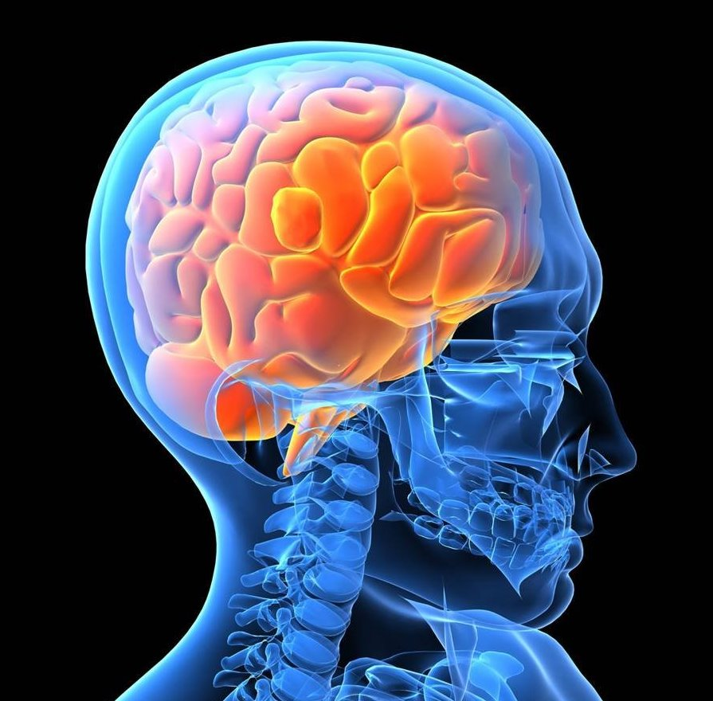
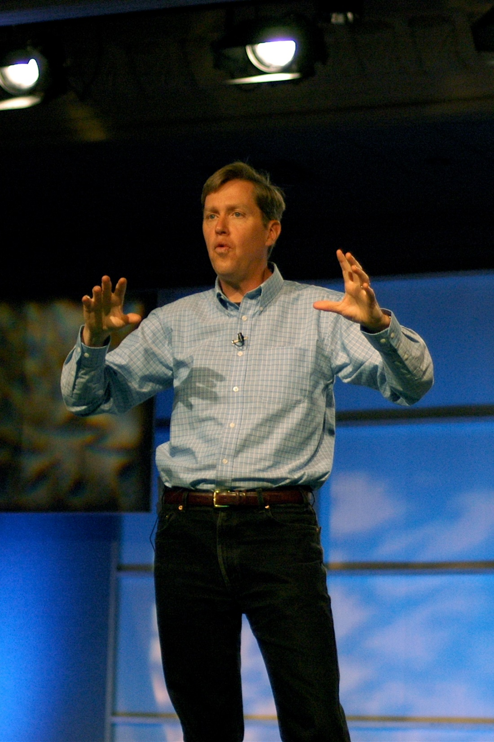
The answer may lay in our brain

Slide 8
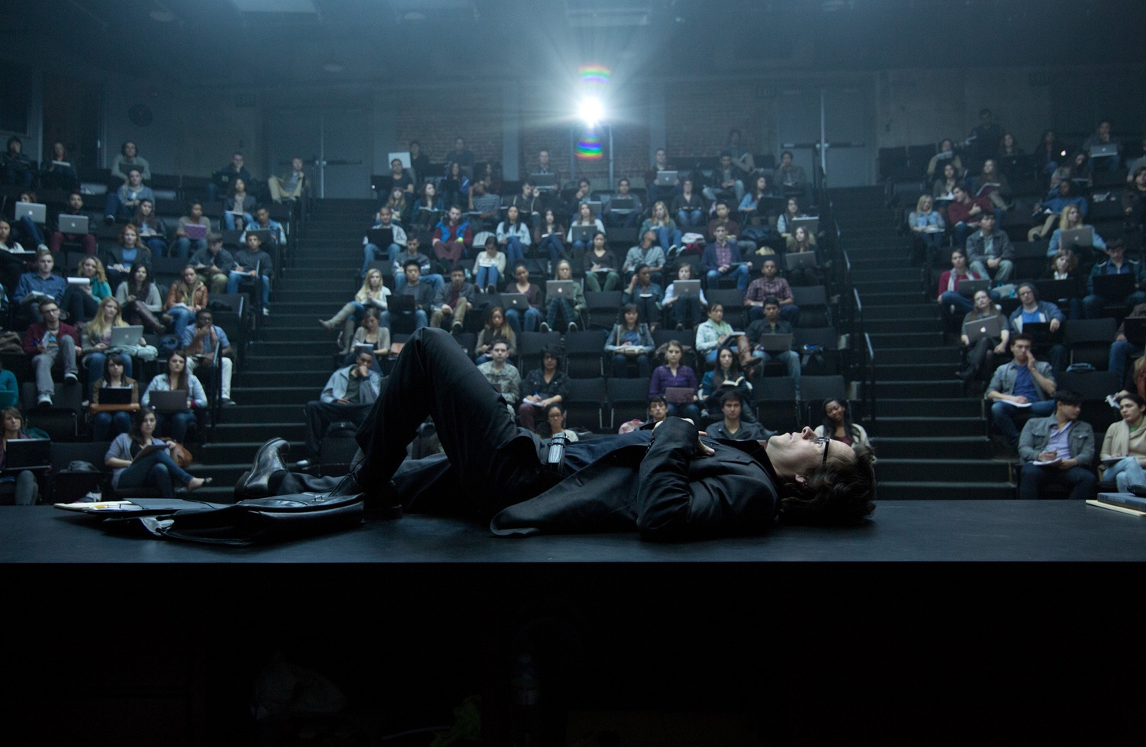
Now its not merely a question of math/stats/compsci:
Its also
A question of our evolutionary process (computational biology)
Neuroscience
Physics
…..
…..
Philosophy
Even liberal arts

Slide 9
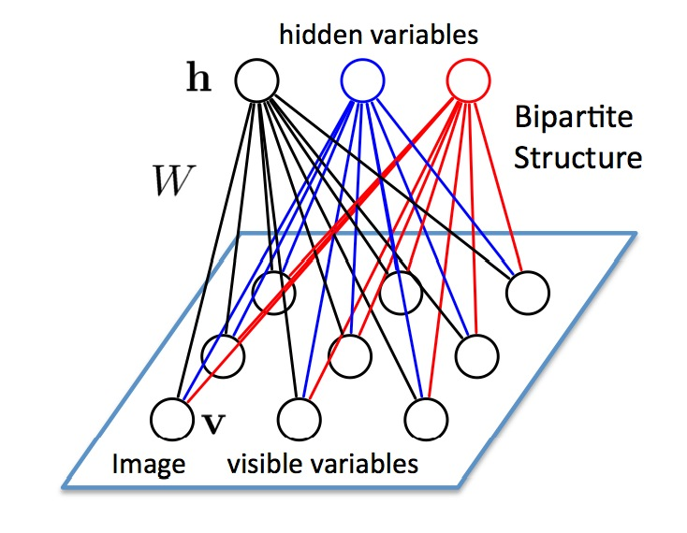
The New Approach
Mimic how our brain works
Neural Networks
Perceptrons
Boltzman Machines
Hopfield networks

Slide 10
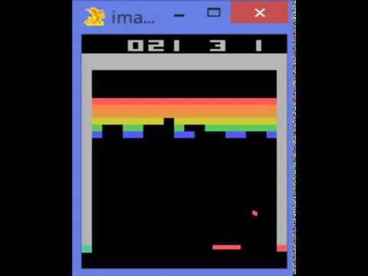

Slide 11

The Rise of The Machines? Nah not really..

Slide 12
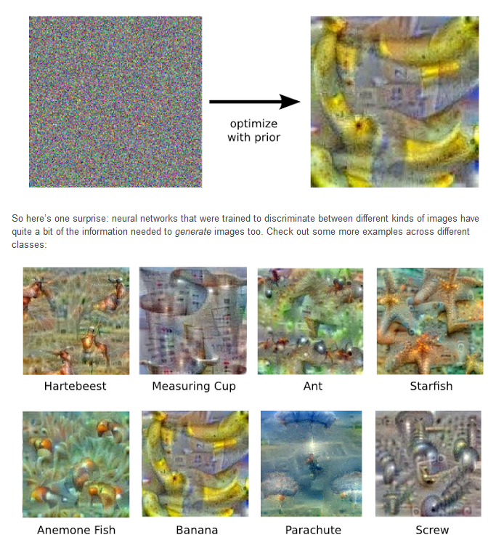
What does this do with images?
Neural Network on Images
The network typically consists of 10-30 stacked layers of artificial neurons. Each image is fed into the input layer, which then talks to the next layer, until eventually the “output” layer is reached. The network’s “answer” comes from this final output layer.

Slide 13
The coolest part? We don’t have understanding of what is going on… :)
We know that after training, each layer progressively extracts higher and higher-level features of the image, until the final layer essentially makes a decision on what the image shows.
For example, the first layer maybe looks for edges or corners. Intermediate layers interpret the basic features to look for overall shapes or components, like a door or a leaf.
The final few layers assemble those into complete interpretations—these neurons activate in response to very complex things such as entire buildings or trees.

Slide 14
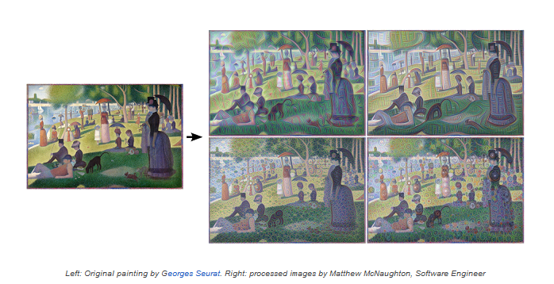

Slide 15
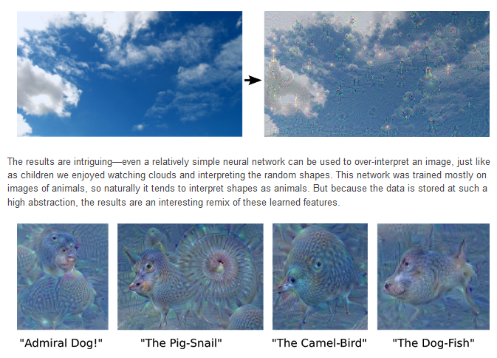

Slide 16
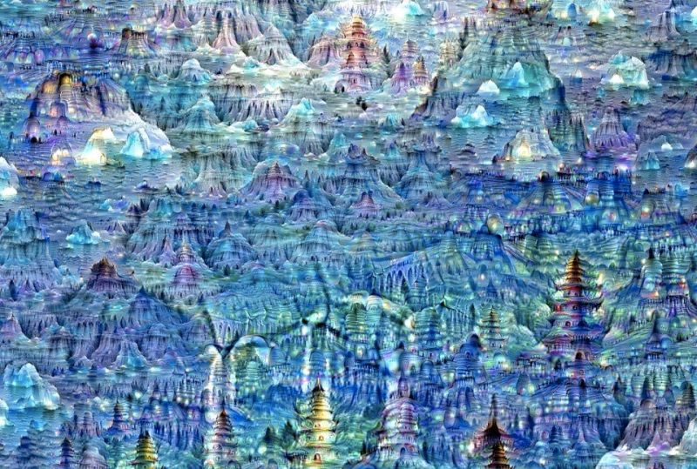
The computer on mushrooms :D

Slide 17
Imaginary Neural Network
If we apply the algorithm iteratively on its own outputs and apply some zooming after each iteration, we get an endless stream of new impressions, exploring the set of things the network knows about. We can even start this process from a random-noise image, so that the result becomes purely the result of the neural network.
https://github.com/szagoruyko/imagine-nn -> Imagine Neural network repo

Slide 18
The machine could dream. WHAT IFFFFFFFFF…..
WE TOLD THEM TO DRAW PAINTINGS. COULD THEY DO IT…

Slide 19
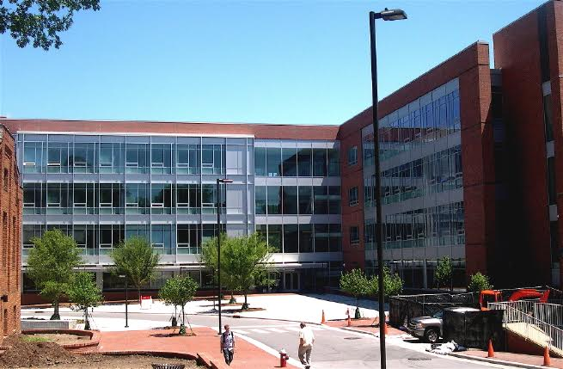
Feed the machine these images for concepts
SAS Hall
Stary Night by Vincent Van Gogh

Slide 20
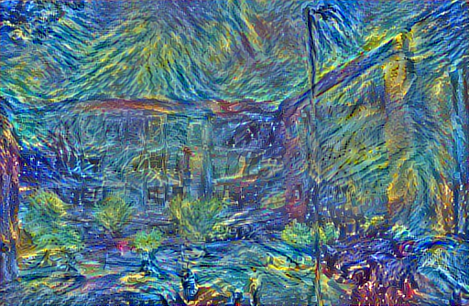
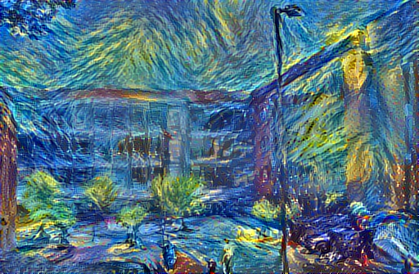
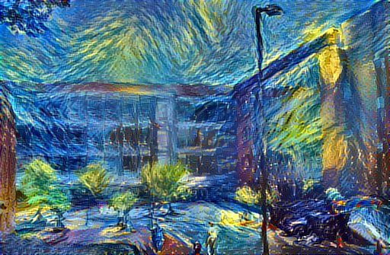
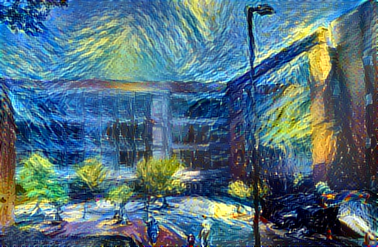
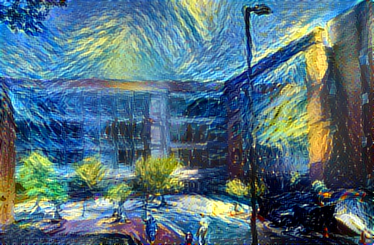
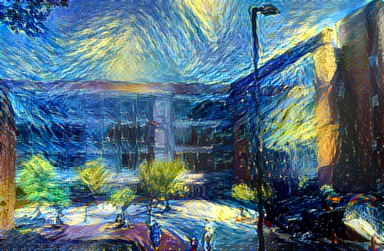

Slide 21
PROOF OF CONCEPT ON-THE-FLY DEMO
TORCH ON NVIDIA GPU G8 INSTANCE ON THE CLOUD – AMAZON WEB SERVICES

Slide 22

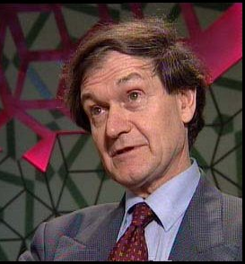
The future will look bright
There are still a lot that we dunno about the brain
Quantum Hopfield networks
Microtubles as micro quantum computers (qubit processors)

Slide 23
Any sufficient advance technology is indistinguishable from magic.
- Arthur C. Clark

